Slide 1

3. Diagram T-s or h-s
Enthalpy, Entropy: State parameters
2 parameters can describe state of gas
  By convention, p-v, T-s, h-s

Slide 2
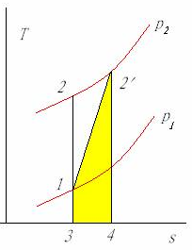
Diag T-s for compression
Equal pressure line p₂>p₁
1-2 comp s constant, Δh=Cp(T₂-T₁)
1-2’ irreversible comp, under same p, Δh=Cp(T’₂-T₁)
312’43 friction heat q_{in}
122’1 due to n ≠ γ
Notes:
qin在p-v图上并不无法表示
解释各温度

Slide 3
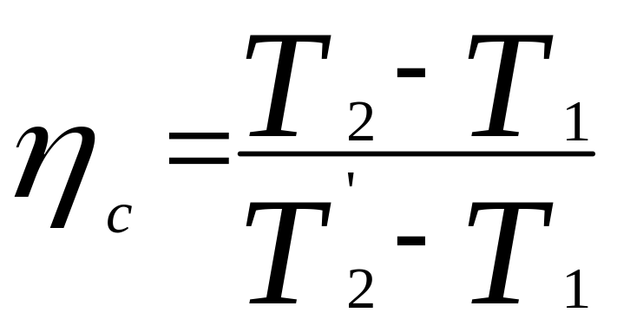
Diag T-s for compression
Total loss 322’43
Compressor efficiency (neglect Cp variation)
Usually use total T
Notes:
qin在p-v图上并不无法表示
解释各温度

Slide 4
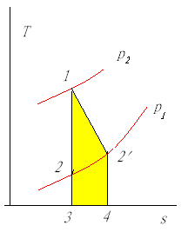
Diag T-s for expansion
Equal pressure line p₂>p₁
1-2 expan s constant, Δh=Cp(T₁-T₂)
1-2’ irreversible comp, under same p, Δh=Cp(T₁-T’₂)
312’43 friction heat q_{in}
122’1 due to n ≠ γ
Notes:
qin在p-v图上无法表示

Slide 5
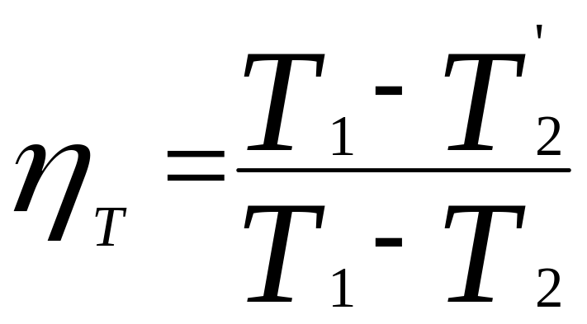
Diag T-s for expansion
Total loss 322’43
Turbine efficiency (neglect Cp variation)
Notes:
qin在p-v图上无法表示

Slide 6
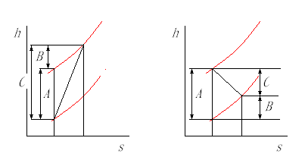
Diagram h-s
Using diagram h-s shows directly relations of energy exchanges
Compression efficiency η_{C}=A/C
Expansion efficiency η_{T}=C/A
Notes:
红的是等压线

Slide 7
4. Cycle and cycle efficiency
Thermal machines transfer heat energy to mechanical energy
Substance——Air
Expansion——Mechanical work
Thermal cycle

Slide 8
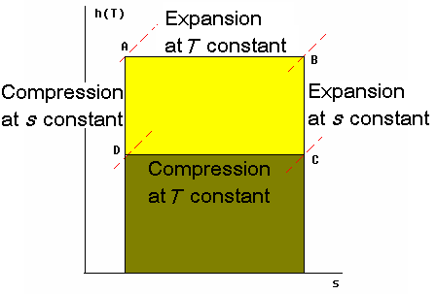
Carnot’s cycle
DA
AB, heating q₁
BC
CD, release heat q₂ unavoidably
Notes:
q2 exists according second law of thermodynamics.

Slide 9
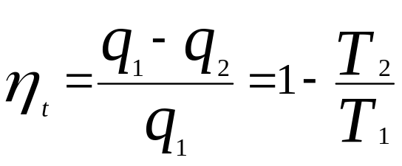
Carnot’s cycle
Efficiency
T₁↑ orT₂ ↓
⇒η_{t} ↑

Slide 10
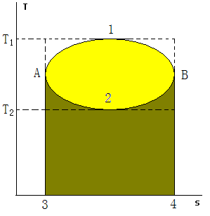
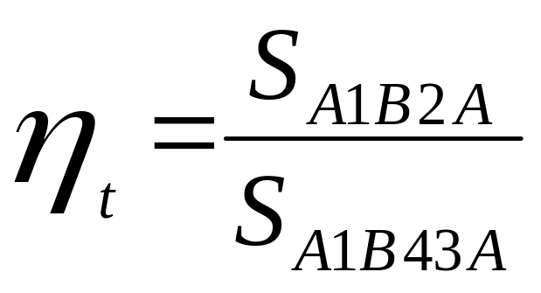
Generic cycle
Efficiency
At the same T₁ and T₂, Carnot’s cycle has the highest efficiency.
Notes:
卡诺循环难实现，讨论热机发展方向。

Slide 11
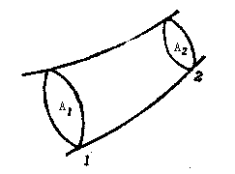
§1.3 Fundamental equations of aerodynamics
1. Continuity equation
  ρ₁A₁v₁=ρ₂A₂v₂=q_{m} (1-29)
  V is speed
  For incompressible, ρ₁=ρ₂ ， A₁v₁=A₂v₂ (1-30)
Notes:
定常流

Slide 12
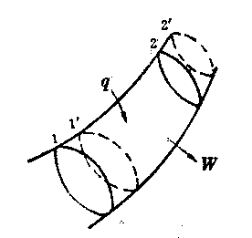
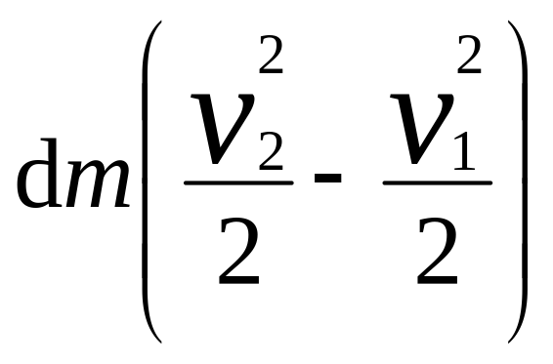
§1.3 Fundamental equations of aerodynamics
2. Energy equation
  A volume of air from 1-2 to 1’-2’ in dt
  Adding heat qdm
  Output work Wdm，dm=vAρdt is mass flow at any section
  Kinetic energy change
Notes:
q,W单位气体的热和功
推导

Slide 13
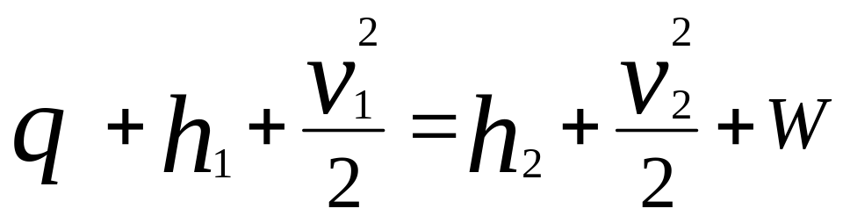
2. Energy equation (Cont'd)
  Internal energy change: dm(u₂-u₁)
  Work to gas
  p₂v₂A₂dt-p₁v₁A₁dt
  Neglecting gravity, then
Notes:
q,W单位气体的热和功
推导
1。Eliminate dm
2。p/ρ+u=h

Slide 14
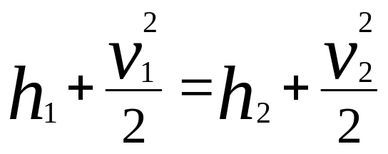
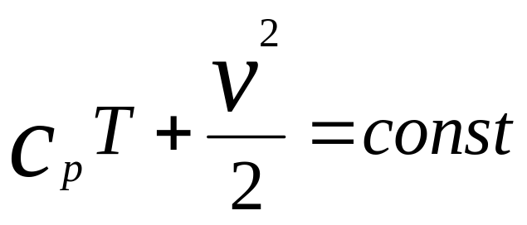
2. Energy equation(Cont'd)
  If q=W=0, then
  or
Notes:
q,W单位气体的热和功
推导

Slide 15
2. Energy equation (Cont'd)
  Means that when gas flowing in a tube (with friction), enthalpy + kinetic energy remains unchanged if no work gets into the act.
Notes:
q,W单位气体的热和功
推导

Slide 16
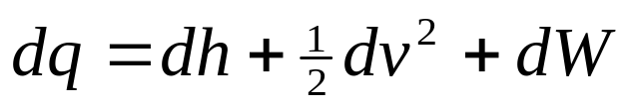
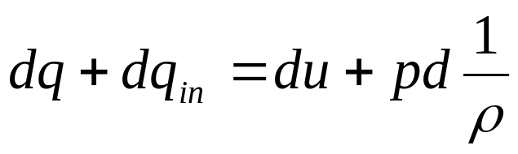
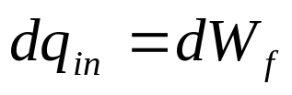
§1.3 Fundamental equations of aerodynamics (Cont'd)
3. Bernoulli’s equation
  Differential for of above equation
  First law of thermodynamics
Notes:
机械能的能量守恒方程
推导——消掉dq,dh,du

Slide 17
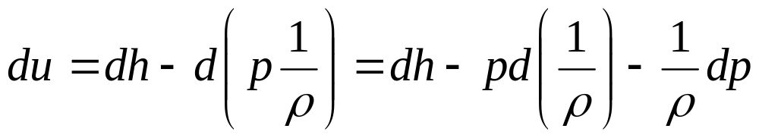
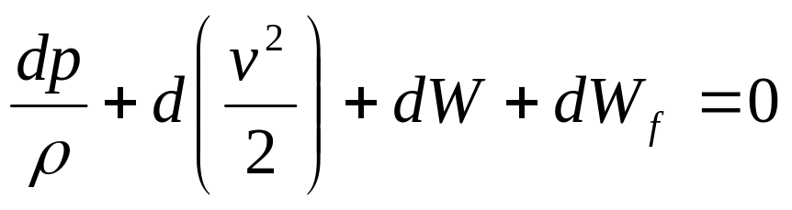
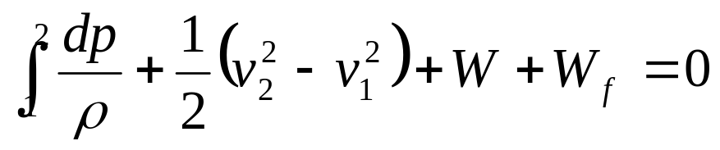
3. Bernoulli’s equation (Cont'd)
  Enthalpy definition
  Then
  Integration
Notes:
机械能的能量守恒方程
推导——消掉dq,dh,du

Slide 18
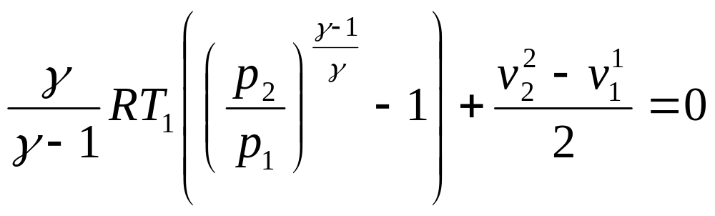
3. Bernoulli’s equation (Cont'd)
  First term depends on the process
  If no work (W=0) and isentropic (W_{f}=0)，pρ^{-γ}=const

Slide 19
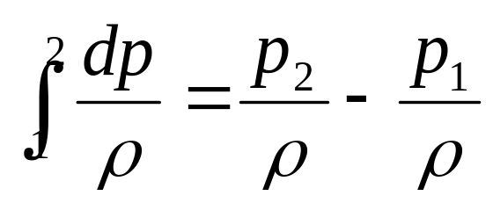
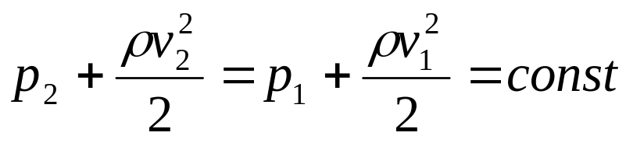
3. Bernoulli’s equation (Cont'd)
  First term depends on the process
  Isentropic and incompressible, W=0:

Slide 20
3. Bernoulli’s equation (Cont'd)
Generic
Isentropic

Slide 21
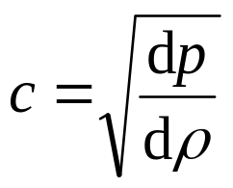
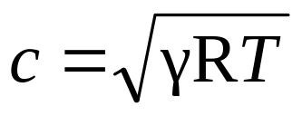
§1.3 Fundamental equations of aerodynamics (Cont'd)
4. Sound speed and Mach number
  Sound speed in fluid
  In air, sound propagation is seen as adiabatic process, ie. pρ^{-γ}= const. Then
  γ——Ratio of specific heats
  R——Gas constant
  T——Absolute temperature
Notes:
r(-g)dp-gpr(-g-1)dr=0
dp/dr=gpr(-g-1)/r(-g)=gpr(-1)=gRT
怎样理解音速
固体材料的音速

Slide 22
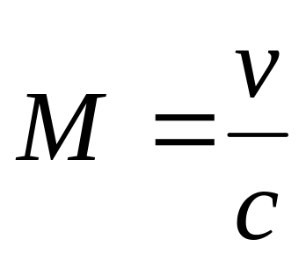
4. Sound speed and M (Cont'd)
  Mach Number
  M>1，Supersonic
  M<1，Subsonic
  M≈1，Transonic

Slide 23
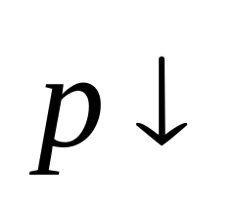
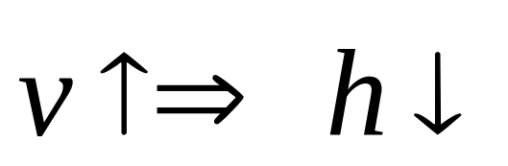
§1.3 Fundamental equations of aerodynamics (Cont'd)
5. Stagnation parameters of flow and aerodynamic functions
  From above equations, flow kinetic energy (speed), enthalpy and pressure potential energy can be converted from one to others.
and
Notes:
h*=CpT*
V为有序运动速度（动能）
T为无序运动动能

Slide 24
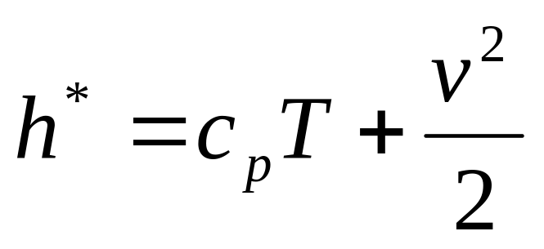
5. Stagnation parameters and functions (Cont'd)
If flow stagnates (v=0) as isentropic process, the kinetic energy is converted totally to enthalpy. It is called stagnation enthalpy, or total enthalpy：
  (1-38)
Notes:
h*=CpT*
V为有序运动速度（动能）
T为无序运动动能

Slide 25
5. Stagnation parameters and functions (Cont'd)
v: ordered movement
T: disordered movement
Notes:
h*=CpT*
V为有序运动速度（动能）
T为无序运动动能

Slide 26
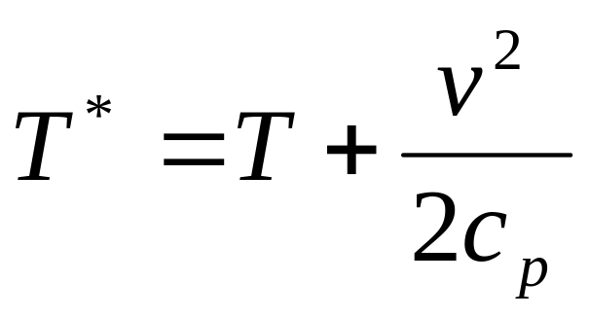
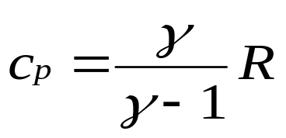
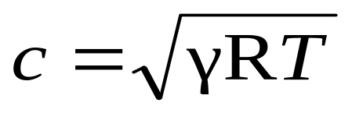
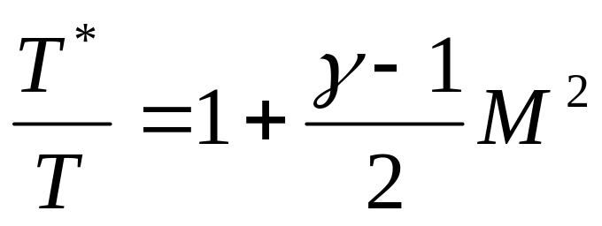
5. Stagnation parameters and functions (Cont'd)
  Corresponding stagnation temperature or total temperature: (1-39)
  Since
  （1-40）
Notes:
h*=CpT*

Slide 27
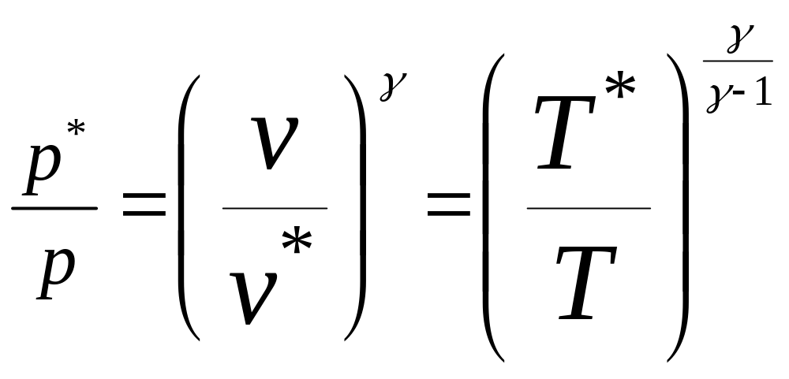
Stagnation process
  It’s isentropic, so
Notes:
可逆过程，因为只有外热，dq=du+pdv, 得ds=CvdT/T+Rdv/v。积分得熵增。

Slide 28
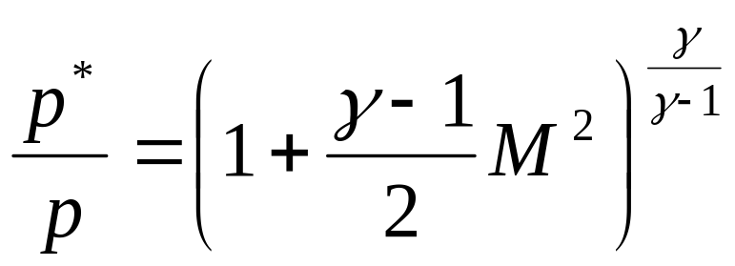

5. Stagnation parameters and functions (Cont'd)
  Since stagnation is isentropic, so:
  (1-41)
  (1-42)
  p*——Total Pressure
  ρ*——Total Density

Slide 29
5. Stagnation parameters and functions (Cont'd)
  According to the 3 equations above, for a given gas flow, the ratios of the total parameters and steady parameters are function of Mach number.
  When air flows isentropically in a tube without energy added, the total parameters (Enthalpy, temperature, pressure and density) remain unchanged.

Slide 30

5. Stagnation parameters and functions (Cont'd)
Critical sound speed c_{cr} (in tunnel)
  v increases along the tunnel (ex. Laval nozzle)
  When v increases, T decreases. Sound speed c is function of T, it goes down.
Notes:
c变， c_{cr}不变

Slide 31
5. Stagnation parameters and functions (Cont'd)
Critical sound speed c_{cr} (in tunnel)
  When v=c, ie M=1, this c has special meaning, called critical sound speed c_{cr}. This section is called critical section and it is the smallest section in the tunnel, also called throat.
Notes:
c变， c_{cr}不变

Slide 32
5. Stagnation parameters and functions (Cont'd)
Critical sound speed c_{cr} (in tunnel)
  c_{cr} is a parameter of the isentropic flow of the tunnel.
  c_{cr} is constant in this kind of flow.
Notes:
c变， c_{cr}不变

Slide 33
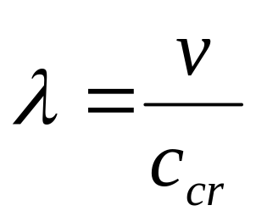
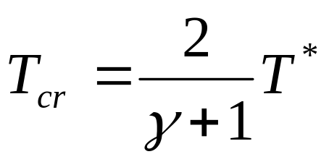
5. Stagnation parameters and functions (Cont'd)
  Definition of speed coefficient in a section
  (1-43)
  From (1-40) , we obtain

Slide 34
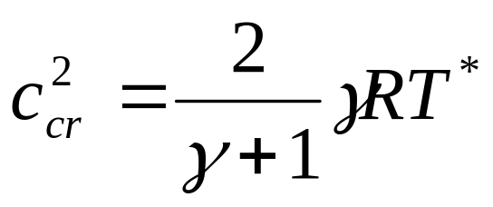
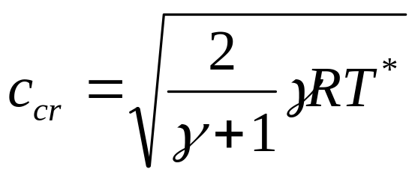
5. Stagnation parameters and functions (Cont'd)
  And

Slide 35
C and C_{cr}
 | C | C_{cr}
Apply to | local | tunnel
Depending on | T | T*
Speed ratio | M | λ
Relation | λ (see following) | M

Slide 36
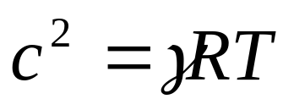
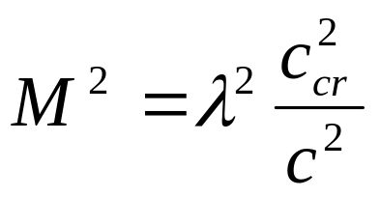
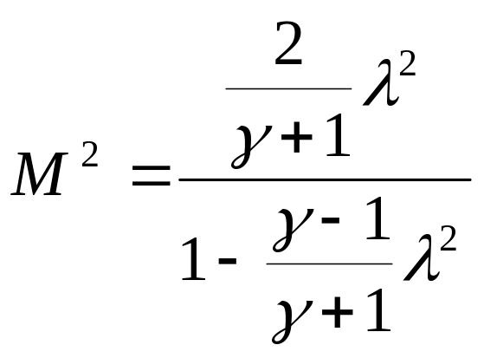
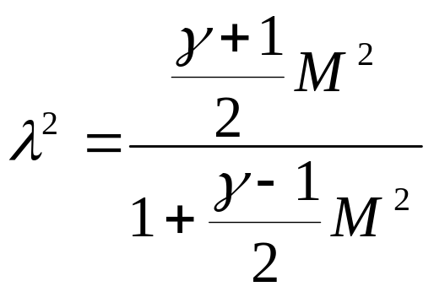
5. Stagnation parameters and functions (Cont'd)
  Using
  in , we obtain
  and
Notes:
消掉T

Slide 37
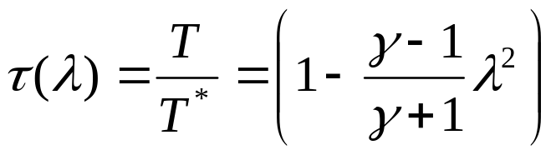
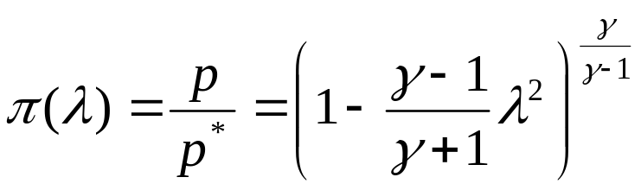
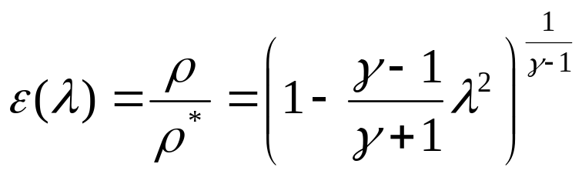
5. Stagnation parameters and functions (Cont'd)
  Change (1-40), (1-41) & (1-42) to
  (1-46)
  (1-47)
  (1-48)
  τ(λ), π(λ) and ε(λ) three aerodynamic func
Notes:
后面要用到这些函数

Slide 38
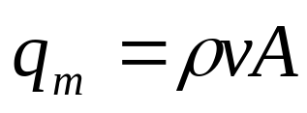
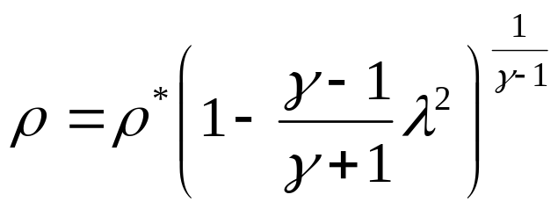
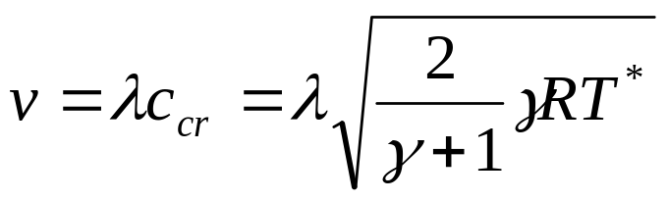

5. Stagnation parameters and functions (Cont'd)
  Flow density function
  kg/s
Notes:
密流函数推导

Slide 39

5. Stagnation parameters and functions (Cont'd)
  Flow density function
  (1-49)
  q(λ) presents relative flow density in section A to the critical section even though the critical section does not exist.
  Ratio of the sections
Notes:
1.密流函数推导
(pv)cr=pv(l=1)

Slide 40



5. Stagnation parameters and functions (Cont'd)
  Using flow density function and total parameters, mass flow can be expressed:
  （1-50）
  where：
  Air 0.04042, gas 0.03968
Notes:
2.用总参数方便
3.推导流量公式

Slide 41

5. Stagnation parameters and functions (Cont'd)
  At the critical section, q(λ)=1.
Notes:
2.用总参数方便
3.推导流量公式

Slide 42

§1.3 Fundamental equations of aerodynamics
6. Equation of momentum
  Based on second Newton’s law
  Momentum change of an object at a period of time is equal to the applied force
  In aircraft engines

Slide 43

§1.3 Fundamental equations of aerodynamics
7. Equation of moment of momentum
  Similar with above equation, but rotational movement

Slide 44
§1.3 Fundamental equations of aerodynamics
8. Shock waves and expansion waves
  Ex. The tail trace when a boat goes with a high speed.
M>1
M=1

Slide 45
8. Shock waves and expansion waves (Cont’d)
  Or bridge pier when water flows.
  Accumulation of disturbances
M>1
M=1

Slide 46

8. Shock waves and expansion waves (Cont’d)
  Intakes: Fig (a) normal shock wave, due to intake’s form; Fig (b) oblique shock wave。The angle β depends on Mach number of the flow and geometrical angle of the cone θ.

Slide 47
8. Shock waves and expansion waves (Cont’d)
  When M reduces or θ increases, will increase until the wave becomes a normal shock wave.

Slide 48
8. Shock waves and expansion waves (Cont’d)
  When supersonic flow passes through the shock wave, sharply speed decreases, pressure and temperature increase.
  After normal wave, the flow is certainly subsonic. But after oblique shock wave, it is still supersonic.

Slide 49
8. Shock waves and expansion waves (Cont’d)
  Strength of the shock wave is described by pressure ratio of after and before. It is only function of M for normal shock wave, the greater M, the stronger the wave.
  For oblique shock wave, the greater M and θ, the stronger the wave.

Slide 50
8. Shock waves and expansion waves (Cont’d)
  Supersonic flow passing through the shock wave is NOT isentropic process. Partial mechanical energy Irreversibly changes to heat, and total pressure decreases.
  This is shock wave loss, and usually total pressure recovery σ is used to present the loss. It is function of the wave strength, the stronger the wave, the greater the loss.

Slide 51

8. Expansion waves (Cont’d)
  When a supersonic air flows to a lower pressure zone, there are expansion waves due to air continuous expansion.
  In Fig, turbine cascade passage. In the throat A—A, critical section, flow becomes supersonic.

Slide 52
8. Expansion waves (Cont’d)
  In downstream, it is low pressure zone. The flow accelerates, it passes through a series of expansion waves, and speed increases, temperature and pressure decrease.

Slide 53
8. Expansion waves (Cont’d)
  The flow changes also the direction. The bigger the turned angle, the more expansion and flow parameters change more.

Slide 54
8. Expansion waves (Cont’d)
  The turned angle depends on exit pressure. The lower the pressure, the bigger the angle.
  If pressure increases, expansion waves may disappear and the flow may be subsonic.

Slide 55
Summary
§1.1 First law of thermodynamics
  Gas, state parameters, gas constants, processes and parameters
  Enthalpy and first law
§1.2 Second law of thermodynamics
  Entropy and second law
  Cycle and efficiency
§1.3 Aerodynamics fundamental equations
  Fundamental equations
  Sound speed and Mach number
  Stagnation parameters and aerodynamic functions
  Shockwaves and expansion waves

